Slide 1

Mobile TA fundamentals
W/ appium

Slide 2




About presenter
Alexander Voronovich
Automation Manager
Alexander_Voronovich
Alexander_Voronovich@epam.com
https://www.linkedin.com/in/alexandervoronovich

Slide 3
PART1: AGENDA
1
What is mobile automation?
2
Why automate?
3
What automate?
4
Application types
5
How to automate tests?
6
Appium overview
7
Environment

Slide 4
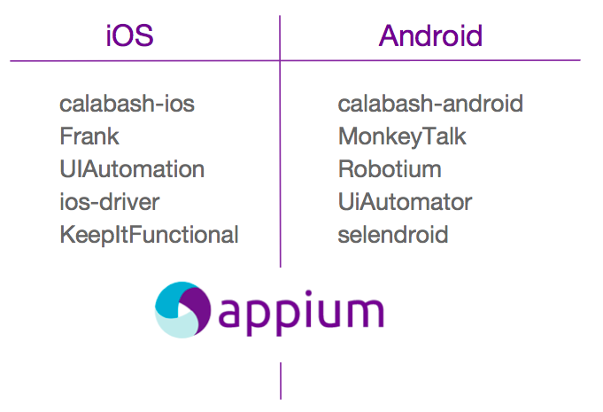
MOBILE TEST AUTOMATION
Tools

Slide 5



3 TOP QUESTIONS

Slide 6
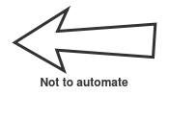
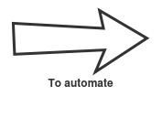
WHY?

Slide 7
WHY: DECISION CRITERIA
Economic benefit / return on investment
efforts for support of autosuite less than efforts for manual execution of the suite, development iterations require execution of suite every time
Software testing process demands
some projects require automation as the only way to testing
Long-running project
every iteration require execution of a big test-suite
Desire and ability to automate
Qualified specialists
Decide whether manual testers are able to automate testing
Customer requirements
focus on the customer
Notes:
Особенность мобильной автоматизации:
Много девайсов (браузеров меньше)
Endurance defects

Slide 8
WHY: OPTIMIZATION OF TESTING PROCESS
Automated tools run tests significantly faster than human users
script don’t need to think what to do, don’t need to use hands or brain to test, and can work without coffe-breaks
Allow testing to happen more frequently
we can run autotests twice a day and get reports faster
Avoiding human factor
script not distracted from work, script can assert everything carefully faster than a human
Emulation of multi-user testing
script can run multithreaded scenarios at one time or emulate crowd of users
Shortens testing cycle
each release need to be tested and we need to spend less time as possible

Slide 9

WHAT?

Slide 10
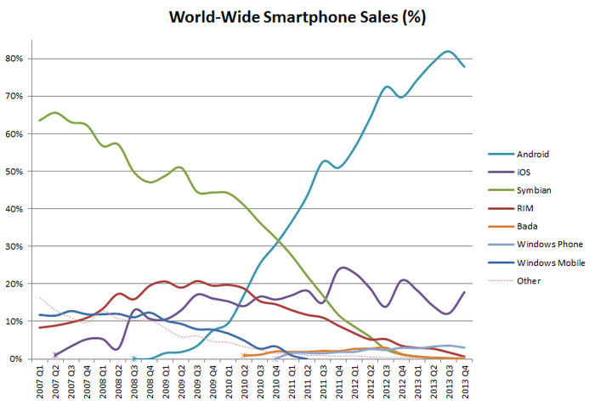
PLATFORMS

Slide 11
APPLICATION TYPES
live on the device
accessed through icons
installed through an application store
developed for one platform
can use all the device features
can work offline
1
NATIVE
not a real application, but a website
run by a browser
typically written in HTML5
accessed by navigation to url
no visible browser buttons or bars
some native features not available
2
WEB
part native, part web
installed from app store
can use device features
use embedded browser
rely on HTML
3
HYBRYD

Slide 12
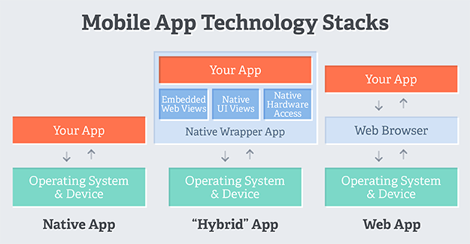
APPLICATION TYPES
How it works

Slide 13
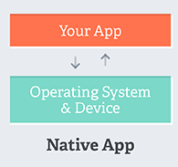
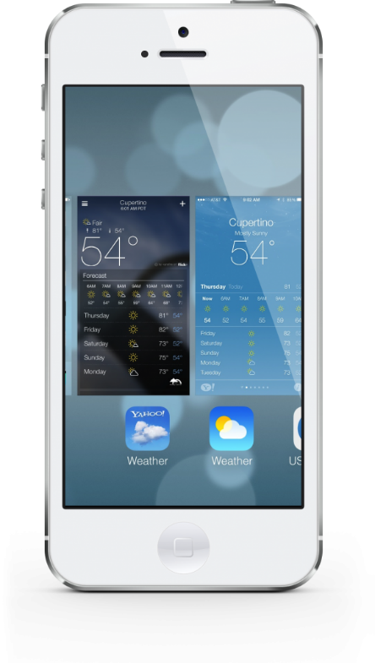
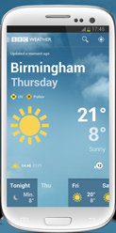
NATIVE APPLICATIONS
live on the device
accessed through icons
installed through an application store
developed for one platform
can use all the device features
can work offline

Slide 14
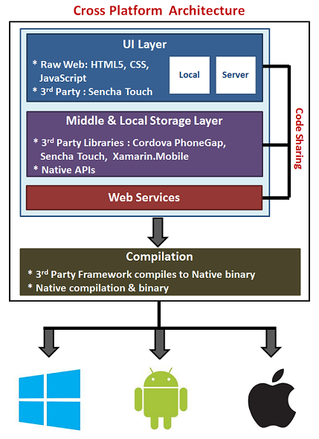


HYBRID APPLICATIONS
part native, part web
installed from app store
can use device features
use embedded browser
rely on HTML
Banana Republic hybrid app for for iOS
Banana Republic hybrid app for Android

Slide 15
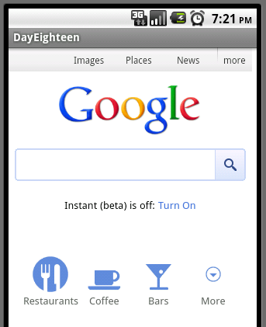
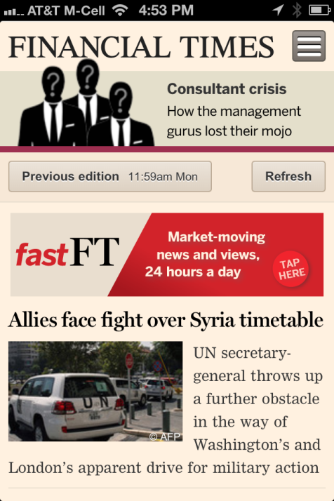
WEB APPLICATIONS
Google web app for Android
not a real application, but a website
run by a browser
typically written in HTML5
accessed by navigation to URL
no visible browser buttons or bars
some native features not available
Financial Times web app for iOS
Notes:
P37 – divide into 2 slides

Slide 16
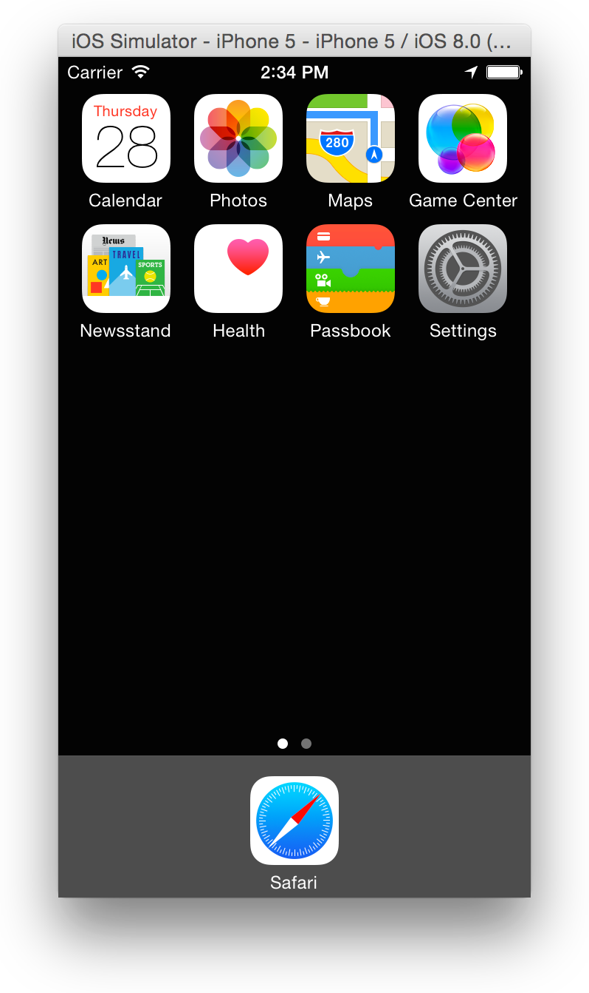
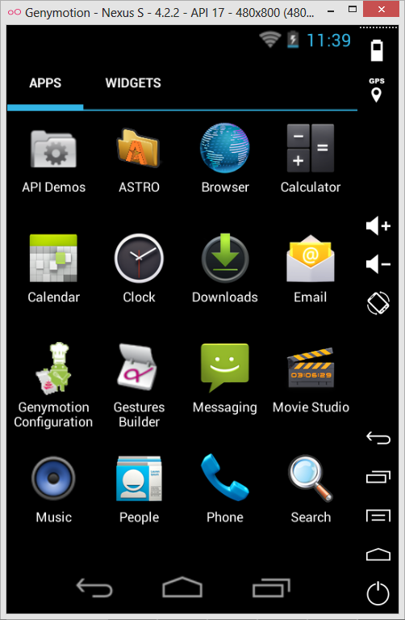
PLATFORMS
Where to run your tests?
iOS
Simulator
Work faster than a real device
No need to add device as developer device
No time limitations between commands
Has differences with real device application
Real device
Real behavior
Time limitation between commands execution for 1 second
Need to be pre-configured with developer account
Android
SDK Simulator
Easy to run and configure
A lot of config abilities
Performance issues
Emulator (Android virtual machine)
Faster than a real devices
Easy to run and configure
Snapshots
Mock settings
Not a real device architecture (can’t run ARM-compiled apps)
Real device
Real behavior
Drivers issues
Device connected issues

Slide 17
HOW

Slide 18
HOW: CRITERIA FOR AUTOMATION TOOL
Mobile OS support (Android, iOS, WP, Firefox OS, BlackBerry)
Single script (to test cross-devices and cross-platform) support
Web/Native/Hybrid apps support
Real device support
Programming languages support (list of languages, or target language)
Test run consistency (make sure that a test script run multiple times will produce the equal results in equal initial conditions)
CI integration
Maintainability (time required to make a change in script)
Video automation
Complex assertions executed against the screen object
SDL friendly test code, code decoupled from low-level locators, etc
SCM support (Git, SVN, CSV, etc.)
UI objects and object properties identification (identify as many as possible elements on UI)
UI hierarchy support, advanced search strategies (XPath, Predicates, etc.)
Text-based object recognition (identifying visible text attribute)
Licensing
Possible to run WebDriver tests against devices from Farm
Possible to integrate with Farm devices
Remote application deployment
Remote application start/stop
Remote application delete
Full remote control to Android/iOS device without root/jailbreak/instrumentation
Use device for short time, ability to see who use it, what application deployed

Slide 19
HOW: SUMMARY
Test Automation requires a software testing process and careful planning.
Do not automate if you have no enough time even for manual testing.
Automation is more than test execution (manage, maintain tests, execute, report the results, manage the test environment).
Select the appropriate testing approach for the project.
Do not attempt to automate everything (not every part of application can be automated).
Manage the automation as a development project (creating autotests is a development)
Develop for maintenance (autotests require ongoing support)

Slide 20

APPIUM

Slide 21
WHY APPIUM
Pros:
The beauty of Appium is that, all the complexities are under the hood of Appium server and for an automation developer the programming language and the whole experience would remain same irrespective of the platform he is automating (iOS or Android).
The other benefits of Appium is that it opens the door to cross-platform mobile testing which means the same test would work on multiple platforms.
Unlike other tools Appium doesn’t require you to include some extra agents in your app to make it automation friendly. It believes in the philosophy of testing the same app which we are going to submit in the app store.
It is developed and supported by Sauce Labs and it is getting picked really fast with in the WebDriver community for mobile automation.
It can automate Web, Hybrid and Native mobile applications.
Cons:
Scaling up is an important consideration with Continuous Integration and Appium comes across as a great tool to fulfill this expectation. The reason for this is a technical limitation, in iOS we can only run one instance on Instruments per Mac OS so we can only run our iOS scripts on one device per mac machine. So if we want to run our tests on multiple iOS devices at the same time then we would need to arrange the same number of Mac machines, which would be costly affair. But this limitation can be resolved if we execute our scripts in Sauce Lab’s mobile cloud which at present supports running scripts on multiple iOS simulators at the same time.
Appium uses UIAutomator for Android automation which only supports Android SDK Platform API 16 or higher so to support the older APIs they have used another open source library called Selendroid. So I would not say it as a limitation but it is definitely an overhead on the configuration side.

Slide 22



APPIUM APPS
Android
Native (SDK >16)
Selendroid
Native Hybrid (SDK < 16)
Chrome
Web
iOS
Native Hybrid
Safari
Web

Slide 23
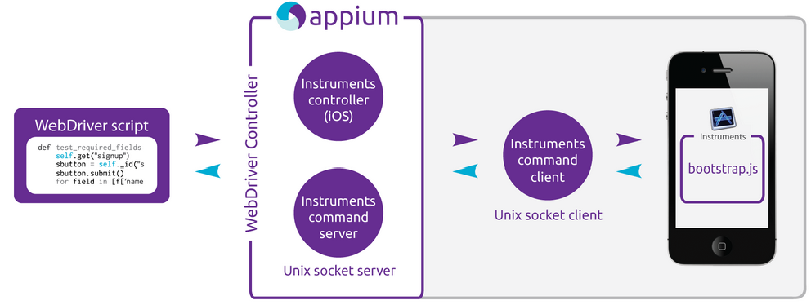
APPIUM IOS
On iOS, Appium proxies command to a UIAutomation script running in Mac Instruments environment. Apple provides this application called ‘instruments’ which is used to do lot activities like profiling, controlling and building iOS apps but it also has an automation component where we can write some commands in javascript which uses UIAutomation APIs to interact with the App UI. Appium utilizes these same libraries to automate iOS Apps.
Notes:
In the above figure, we can see the architecture of the Appium in context to the iOS automation. If we talk about a command life-cycle, it goes like, Selenium webdriver picks a command form the code like (Element.click) and sends it in form of JSon via http request to the Appium server. Appium server knows the automation context like the iOS and Android and sends this command to the Instruments command server which will wait for the Instruments command client (written in node.js) to pick it up and execute it in bootstrap.js with in the iOS instruments environment. Once the command is executed the command client sends back the message to the Appium server which logs everything related to the command in its console. This cycle keeps going till the time all the commands gets executed.

Slide 24
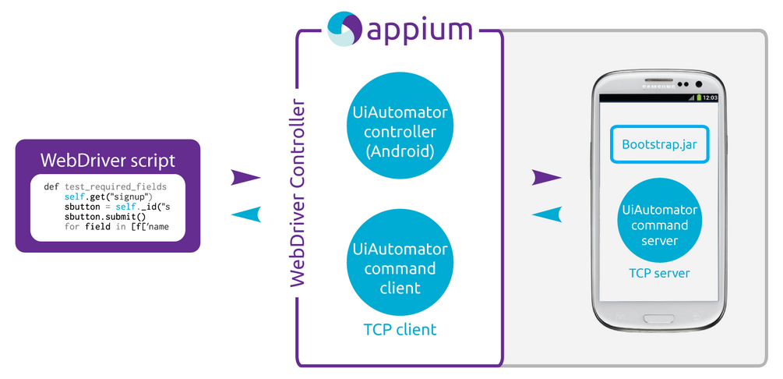
APPIUM ANDROID
The situation is almost similar in case of Android where Appium proxies commands to a UIAutomator test case running on the device. UIAutomator is Android’s native UI automation framework which supports running JUnit test cases directly in to the device from the command line. It uses java as a programming language but Appium will make it run from any of the WebDriver supported languages
Notes:
In the above diagram we can see, here we have Bootstrap.jar in place of bootstrap.js which represents out test case when compiled in java. As soon as it gets launched it spawns a TCP server. Here the TCP server resides inside the device and client is in the Appium process which is just opposite to the way it is in iOS.

Slide 25
PREREQUISITES
iOS
Android
1
Mac OS X
1
Android SDK
2
xCode
2
Emulator or real device
xCode developer tools
Appium server
3
3
4
JDK 1.6+
4
Simulator or real device
5
Appium server
6
JDK 1.6+

Slide 26
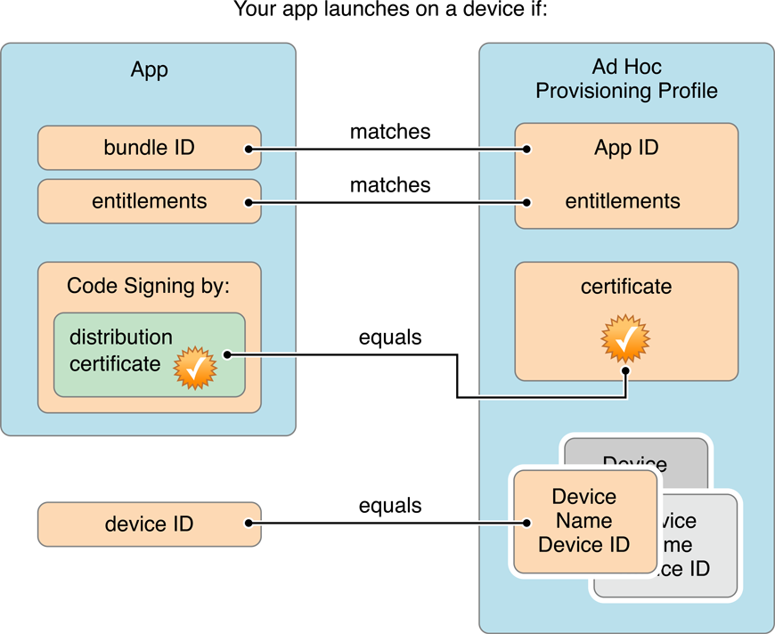
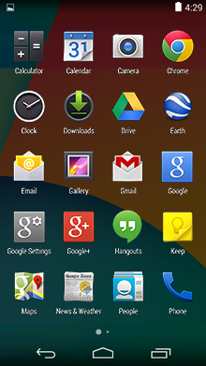
PREREQUISITES
Application requirements
iOS Real device
Signed for development .ipa file
Provisioning profile on device
iOS Simulator
Pre-built for simulator .app file
Android platform
Application .apk file
or installed application

Slide 27
HOW TO RUN APPIUM SERVER
RUN AS DESKTOP APP:
download Appium gui, unpack it and run binary
1
RUN VIA COMMAND LINE WITH NODE.JS LIBRARY:
npm install –g appium
appium
2
BUILD FROM SOURSE CODE AND THAN RUN:
clone repository from github and run build script
3

Slide 28
HOW TO INSTALL ANDROID SDK
1
Download Android SDK Tools and unpack it to suitable folder.
Add $ANDROID_HOME to environment variables with path to SDK. Add folder $ANDROID_HOME/platform-tools to $PATH variable.
2
3
Open SDK Manager and choose SDK Tools version to install

Slide 29
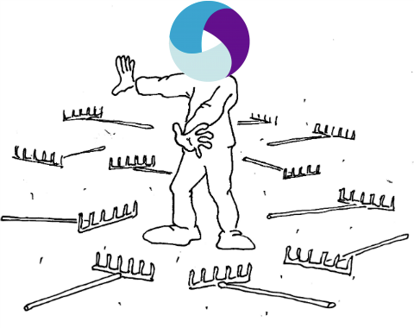
PART2: AGENDA
1
Appium client libraries
2
Driver initialization
3
Finding elements
4
Mobile elements
5
How we do it

Slide 30
APPIUM CLIENT LIBRARIES
Language/Framework | Github Repo and Installation Instructions
Ruby | https://github.com/appium/ruby_lib
Python | https://github.com/appium/python-client
Java | https://github.com/appium/java-client
JavaScript (Node.js) | https://github.com/admc/wd
Objective C | https://github.com/appium/selenium-objective-c
PHP | https://github.com/appium/php-client
C# (.NET) | https://github.com/appium/appium-dotnet-driver
RobotFramework | https://github.com/jollychang/robotframework-appiumlibrary
Notes:
The Appium server itself defines custom extensions to the official protocols, giving Appium users helpful access to various device behaviors (such as installing/uninstalling apps during the course of a test session). This is why we need Appium-specific clients, not just the ‘vanilla’ Selenium clients. Of course, Appium client libraries only add functionality (in fact, they simply extend the standard Selenium clients), so they can still be used to run regular Selenium sessions.

Slide 31
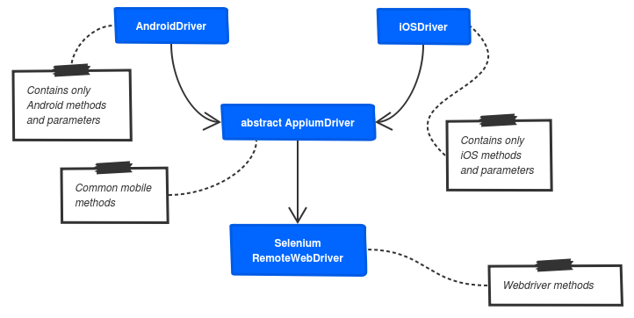
APPIUM CLIENT LIBRARIES
JAVA CLIENT LIBRARY STRUCTURE
Notes:
There is an abstract AppiumDriver class which inherits from the Selenium Java Client. The AppiumDriver class contains all methods shared by iOS and Android. IOSDriver and AndroidDriverboth extend AppiumDriver and provide more methods, and specific implementations for some methods.

Slide 32
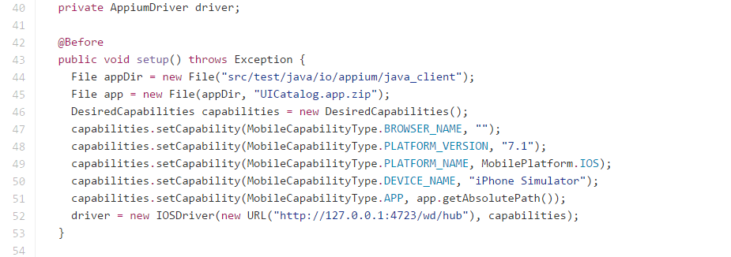
DRIVER INITIALIZATION
Initialize driver
Driver type: iOSDriver, AndroidDriver
Driver URL
Capabilities

Slide 33
DRIVER INITIALIZATION
Main driver capabilities
Capability | Description | Values
automationName | Which automation engine to use | Appium (default) or Selendroid
platformName | Which mobile OS platform to use | iOS, Android, or FirefoxOS
platformVersion | Mobile OS version | e.g., 7.1, 4.4
deviceName | The kind of mobile device or emulator to use | iPhone instruments -s devices. On Android this capability is cuSimulator, iPad Simulator, iPhone Retina 4-inch, Android Emulator, Galaxy S4, etc…. On iOS, this should be one of the valid devices returned by instruments withrrently ignored.
app | The absolute local path or remote http URL to an .ipa or .apk file, or a .zip containing one of these. Appium will attempt to install this app binary on the appropriate device first. Note that this capability is not required for Android if you specify appPackage and appActivity capabilities (see below). Incompatible with browserName. | /abs/path/to/my.apk or http://myapp.com/app.ipa
browserName | Name of mobile web browser to automate. Should be an empty string if automating an app instead. | ‘Safari’ for iOS and ‘Chrome’, ‘Chromium’, or ‘Browser’ for Android
newCommandTimeout | How long (in seconds) Appium will wait for a new command from the client before assuming the client quit and ending the session | e.g. 60

Slide 34
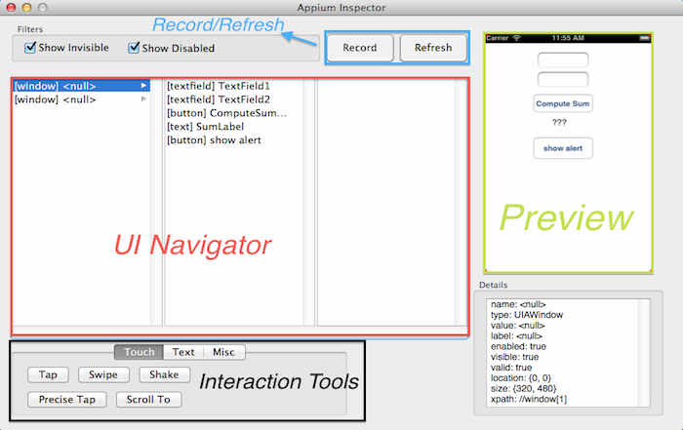
FINDING ELEMENTS
Appium Inspector
Appium provides you with a neat tool that allows you to find the the elements you’re looking for without leaving the Appium app. With the Appium Inspector (the i symbol next to the start test button) you can find any element and it’s name by either clicking the element on the preview page provided, or locating it in the UI navigator.
Notes:
On MAC better

Slide 35
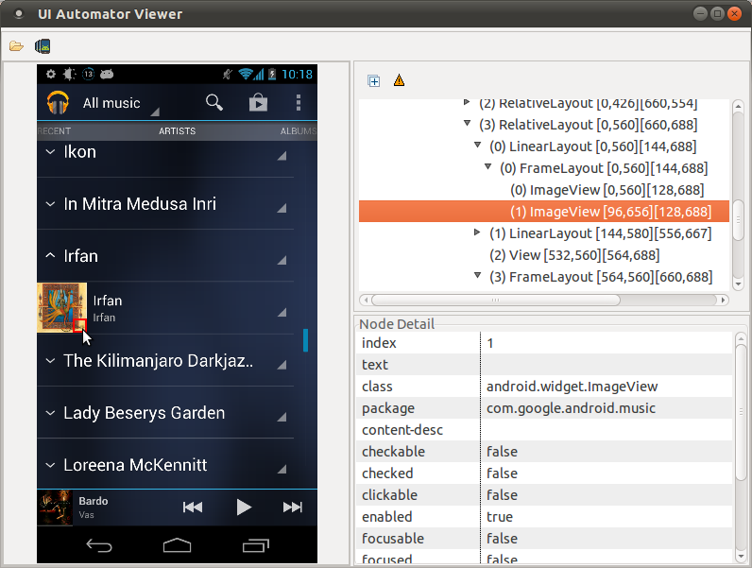
FINDING ELEMENTS
UiAutomatorViewer
You can use the uiautomatorviewer tool to take a snapshot of the foreground UI screen on any Android device that is connected to your development machine. The uiautomatorviewer tool provides a convenient visual interface to inspect the layout hierarchy and view the properties of the individual UI components that are displayed on the test device.
UiAutomatorViewer tool is a part of Android SDK and located in tools folder.
On windows computers preferable to use this tool instead of Appium Inspector, because of bugs and instability of open source Inspector.

Slide 36
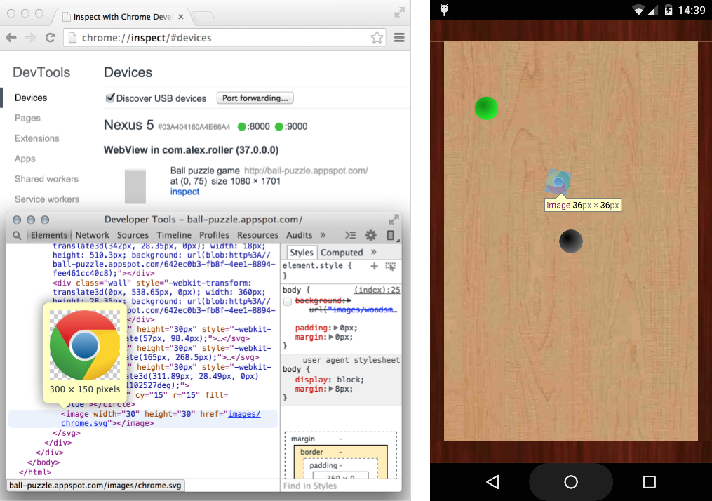
FINDING ELEMENTS
Remote Debugging on Android with Chrome
The way your web content behaves on mobile can be dramatically different from the desktop experience. Remote debugging with Chrome DevTools lets you debug live content on your Android device from your development machine.
Debugging websites in browser tabs.
Debugging WebViews in native Android apps.
Screencasting live to your development machine from your Android device.
Accessing your development server on Android using port forwarding and virtual host mapping.

Slide 37
FINDING ELEMENTS
WebDriver locator strategies
className =“android.widget.EditText”
`class name`: a string representing the UI element type for a given platform, e.g., `UIAPickerWheel` for iOS or `android.widget.Button` for Android
xpath=“//android.widget.EditText[@text=‘test’]”
`xpath`: a valid xpath string applied to the XML document that would be retrieved using the page source command
name=“Search query”
‘name’: a string depending to element type tries to find element by name attribute
accessibilityId=“Button One”
`accessibility id`: a string corresponding to a recursive element search using the Id/Name that the native Accessibility options utilize.
id=“android:id/search_src_text”
`id`: a string corresponding to a resource ID
Notes:
These locator strategies provides by selenium json wire protocol, and appium automatically converts it to unique platform locators

Slide 38
FINDING ELEMENTS
iOS predicates
Native JS search strategy (powered by Apple) provides much more flexibility and is like Xpath.
Predicates works faster than xpath because Apple’s UIAutomation not using xpath to interacting with elements and appium just compile your xpath to something like “/1/1/1/3/4/1”.
Predicate: “.tableViews()[1].cells().firstWithPredicate("label == 'Olivia' ")“
Same in Xpath: “/UIATableView[2]/UIATableCell[@label = 'Olivia'][1]”
BEGINSWITH - The left-hand expression begins with the right-hand expression.
.scrollViews()[3].buttons().firstWithPredicate("name BEGINSWITH 'results toggle' ")
CONTAINS - The left-hand expression contains the right-hand expression.
.tableViews()[1].cells().withPredicate("ANY collectionViews[0].buttons.name CONTAINS 'opera'")
ENDSWITH - The left-hand expression ends with the right-hand expression.
LIKE - .tableViews()[0].cells().firstWithPredicate("name LIKE '*Total: $*' ")
MATCHES - The left hand expression equals the right hand expression using a regex -style comparison
.tableViews().firstWithPredicate("value MATCHES '.*of 7' ")

Slide 39
FINDING ELEMENTS
iOS predicates
Predicate: “.tableViews()[1].cells().firstWithPredicate("label == 'Olivia' ")“
Same in Xpath: “/UIATableView[2]/UIATableCell[@label = 'Olivia'][1]”
You can’t locate elements in WebViews via predicates, for this use xpath strategy
Do not forget to use point (“.”) before predicate
Predicates can’t find branch of element tree by pattern, you need to locate root element carefully
Do not forget to escape quotes in your predicates (\“predicate\”)
Element indexes as “[5]” and “index== ‘5’” is not the same predicate. Attribute ‘index’ may differ from DOM tree index

Slide 40
FINDING ELEMENTS
UiSelector (Android UI Automator)
Specifies the elements in the layout hierarchy for tests to target, filtered by properties such as text value, content-description, class name, and state information. You can also target an element by its location in a layout hierarchy.
UiSelectors are faster and more flexible for android elements than xpath.
Examples:
text("Recent Activity")
className("android.widget.ProgressBar”)
text("Collaborator").className("android.widget.CheckedTextView")
text("Create PIN")
resourceId("com.appname.widgetname:id/buttonOk")
description("imgLoginLogo")
You can’t locate elements in WebViews via UiSelectors
Do not forget to escape quotes in your locators (resourceId(\”com.namename:id/ok\”))

Slide 41

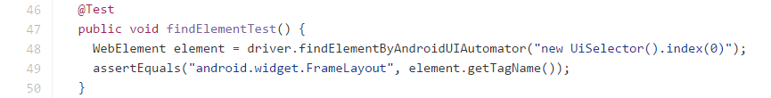
FINDING ELEMENTS
Examples
Via annotations
Selenium findElement
AndroidDriver uiautomator

Slide 42
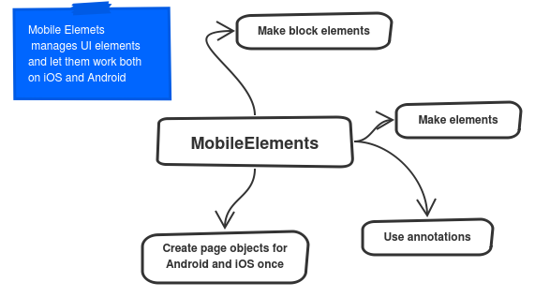
MOBILE ELEMENTS
library
Notes:
This framework is derived from Yandex HtmlElements to provide easy-to-use way of interaction with mobile elements on the page in your tests. It may be considered as an extension of WebDriver PageObject and HtmlElements Block. With the help of MobileElements framework you can group mobile elements into mobile blocks, encapsulate logic of interaction with them and then easily use created blocks in page objects (just like in case of HtmlElements usage for WebUI).
Using this framework assumes that mobile AUT has similar UI both for Android, IOS and/or Web and operates in the same way for selected platforms. In such case it make sense to use single field that represents UI element for several platforms and which is decorated with Android-specific, iOS-specific and/or Web-specific annotations (containing element platform-dependent location strategy). So the main idea is to have the same UI pages set and the same UI tests set for Android/iOS/Web which will reduce maintenance effort in the future.

Slide 43
MOBILE ELEMENTS
annotations
Selenium WebDriver
Html Elements
Mobile Elements
@FindBy
@FindBys
@FindAll
@Block
@IOSFindBy
@IOSFindBys
@IOSFindAll
@IOSBlock
@AndroidFindBy
@AndroidFindBys
@AndroidFindAll
@AndroidBlock

Slide 44
MOBILE ELEMENTS
Page object example

Slide 45
MOBILEELEMENTS
Block element example
Create blocks of elements
Let's assume that we have an application where many pages contain left-side menu:
Notes:
This framework is derived from Yandex HtmlElements to provide easy-to-use way of interaction with mobile elements on the page in your tests. It may be considered as an extension of WebDriver PageObject and HtmlElements Block. With the help of MobileElements framework you can group mobile elements into mobile blocks, encapsulate logic of interaction with them and then easily use created blocks in page objects (just like in case of HtmlElements usage for WebUI).
Using this framework assumes that mobile AUT has similar UI both for Android, IOS and/or Web and operates in the same way for selected platforms. In such case it make sense to use single field that represents UI element for several platforms and which is decorated with Android-specific, iOS-specific and/or Web-specific annotations (containing element platform-dependent location strategy). So the main idea is to have the same UI pages set and the same UI tests set for Android/iOS/Web which will reduce maintenance effort in the future.

Slide 46
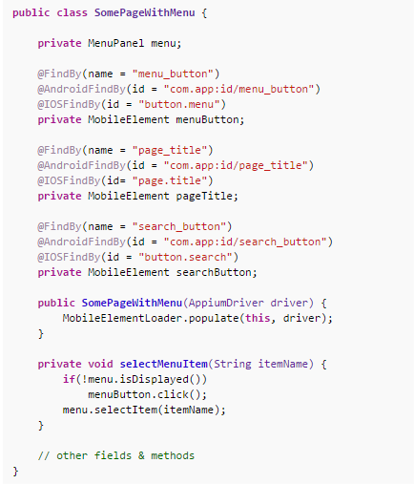
MOBILE ELEMENTS
Block element example
Construct page object using created blocks
You can easily use created blocks in page objects:
Notes:
This framework is derived from Yandex HtmlElements to provide easy-to-use way of interaction with mobile elements on the page in your tests. It may be considered as an extension of WebDriver PageObject and HtmlElements Block. With the help of MobileElements framework you can group mobile elements into mobile blocks, encapsulate logic of interaction with them and then easily use created blocks in page objects (just like in case of HtmlElements usage for WebUI).
Using this framework assumes that mobile AUT has similar UI both for Android, IOS and/or Web and operates in the same way for selected platforms. In such case it make sense to use single field that represents UI element for several platforms and which is decorated with Android-specific, iOS-specific and/or Web-specific annotations (containing element platform-dependent location strategy). So the main idea is to have the same UI pages set and the same UI tests set for Android/iOS/Web which will reduce maintenance effort in the future.

Slide 47
HOW WE DO IT
Main principles
Private fields to elements on the screen
Atomic methods to manipulate screen
No assertions in Page Objects
Steps do not extends each other
Steps do not inject each other
Steps use only pages (page factory)
Steps might invoke Context

Slide 48
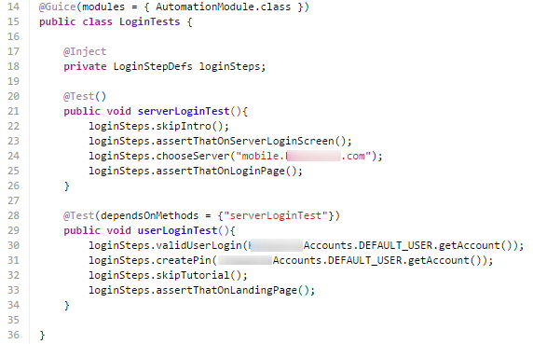
HOW WE DO IT
Autotests
Autotests contains main tests logic
AutomationModule contains steps definitions objects
Test methods annotated with @Test
Example:

Slide 49
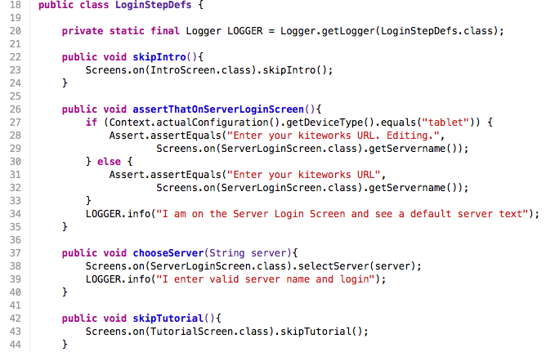
HOW WE DO IT
Steps Wrappers
Steps Wrappers
Tests steps
Log messages
Page objects calls
Exapmple:

Slide 50
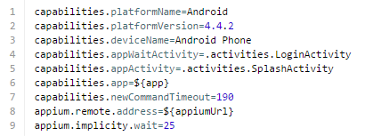
HOW WE DO IT
Properties
Properties for platforms are driver capabilities and they’re put into properties files located in
src\main\resources
Example:

Slide 51
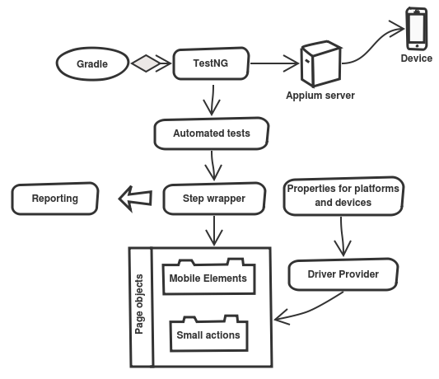
HOW WE DO IT
Framework structure
Gradle used as main build automation system but can be changed to Maven or other
TestNG is a testing framework inspired from JUnit and Nunit
Autotests contains main tests logic
Steps wrappers is a test steps definitions contains test actions
Page objects contains elements and atomic actions to use this elements
Properties for platforms are driver capabilities and they’re put into properties files.
Driver provider makes singleton instance of appium driver with platform capabilities.

